Slide 1

"Cinematic Insights: - Movie Domain Popularity, User Engagement, and Revenue Surge in 2006"
Presented by: Mahmuda Akhtar, Sakib Hosen Himel, Prashant Kumar, Zabihullah Azimy
Business Intelligence
M.Sc Data Science
20/Nov/2023

Slide 2
Agenda:
Business objectives
Schema
Approach to project execution
Analysis questions
Exploring answers to the questions
Challenges
Queries
References

Slide 3

Business objectives:
Investigating Key Performance Indicators associated with the AOL dataset.
Examining user actions in terms of search activities and browsing habits.
Recognize the fundamental themes emerging from the search queries.

Slide 4
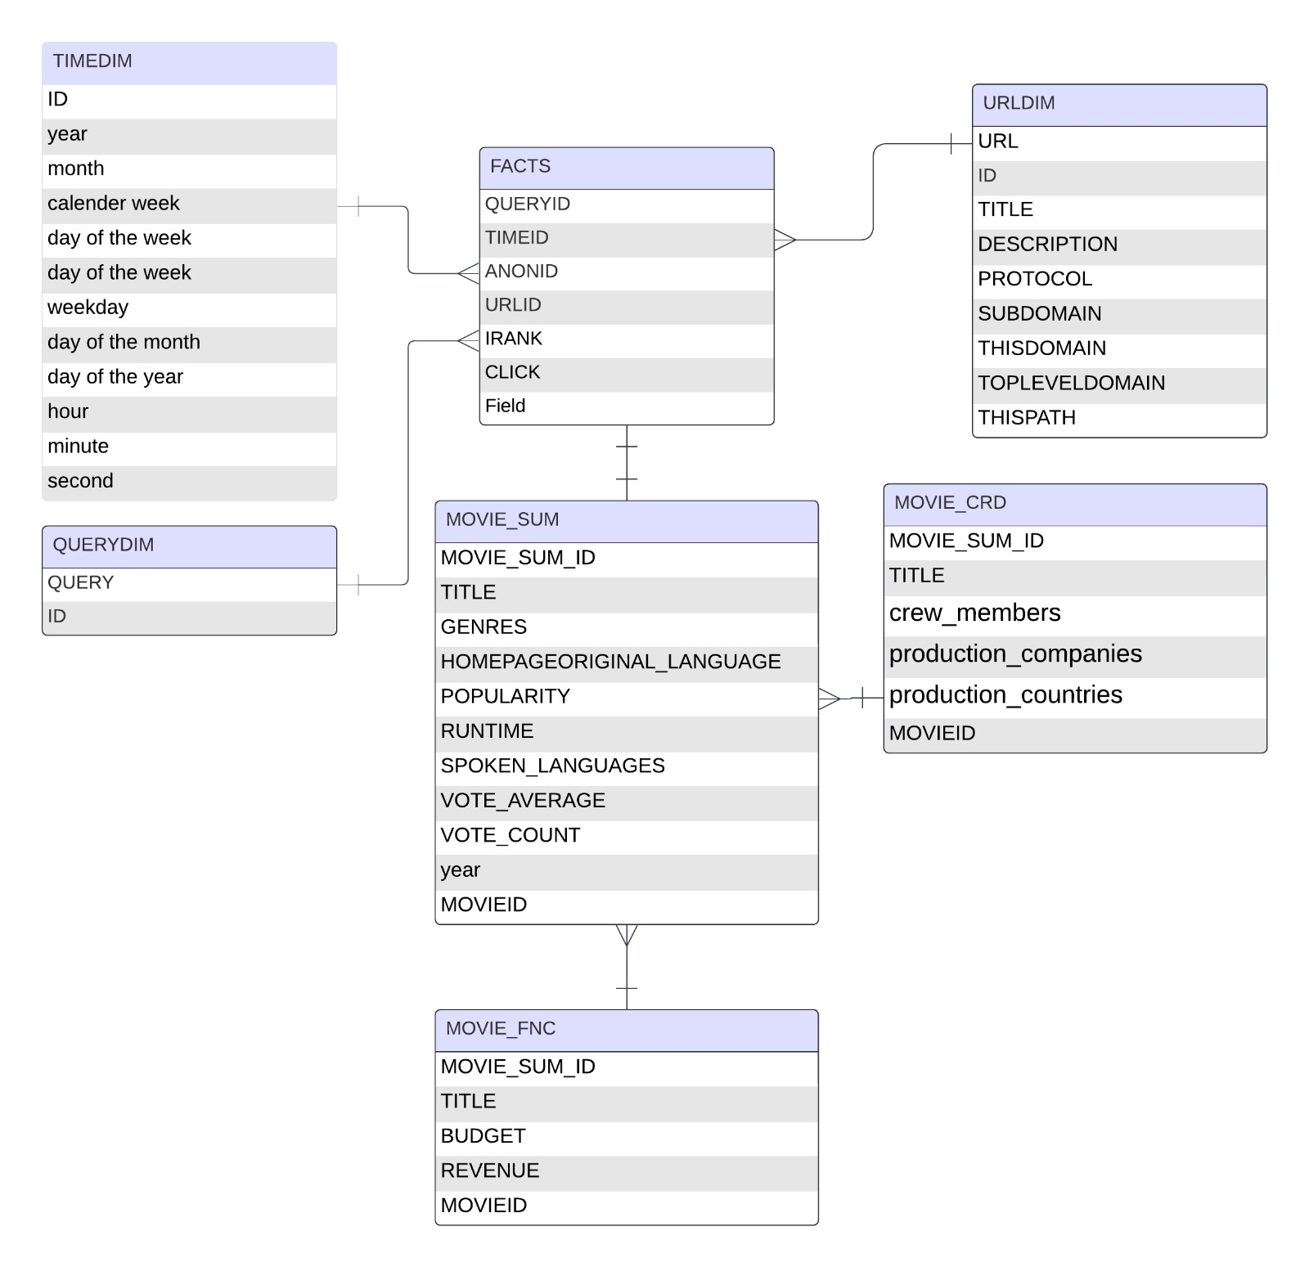
Snowflakes Schema

Slide 5




Approach to project execution
Lookup and Search to find data from different sources. First the existing AOL data and then external data such as IMDB datasets are imported.
Integration of the data into warehouse architecture to further be able to execute queries on the bulk of data.
Investigate
Exploratory analysis and learn for improving decision making and intelligence

Slide 6
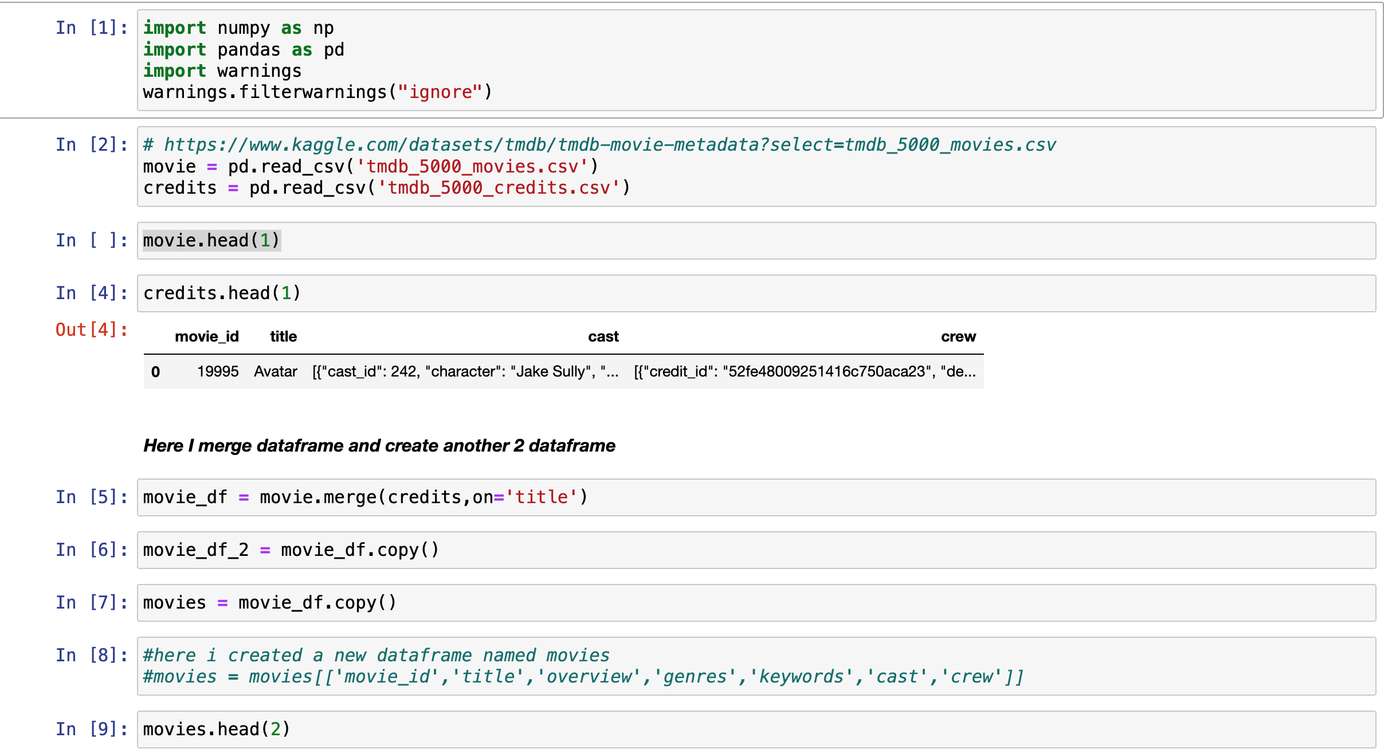
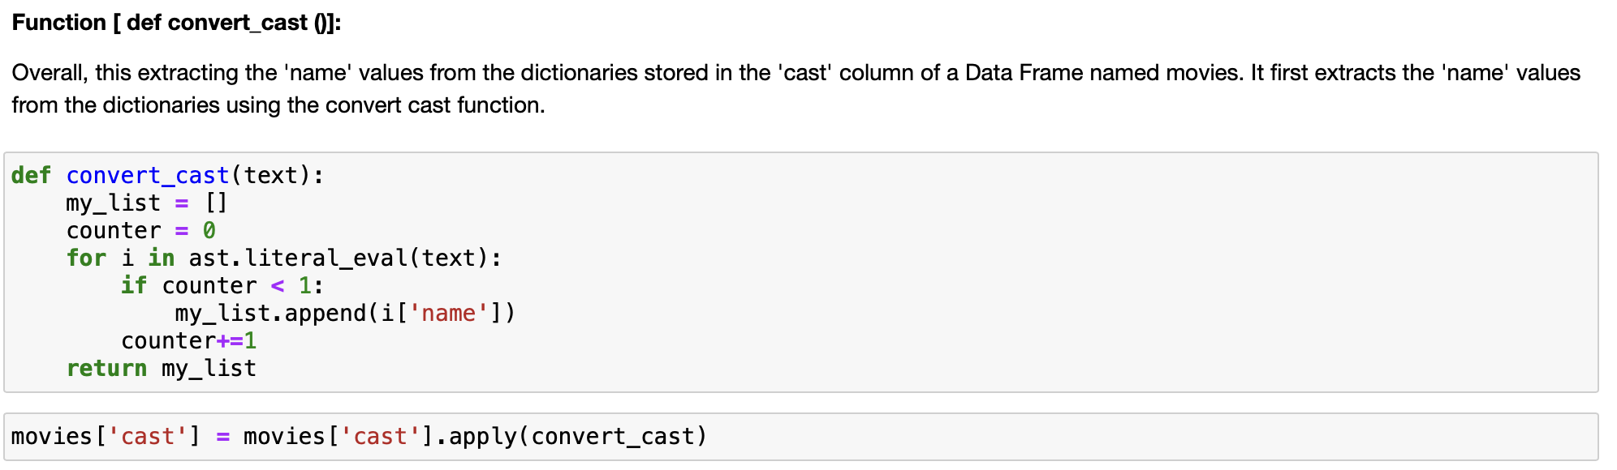
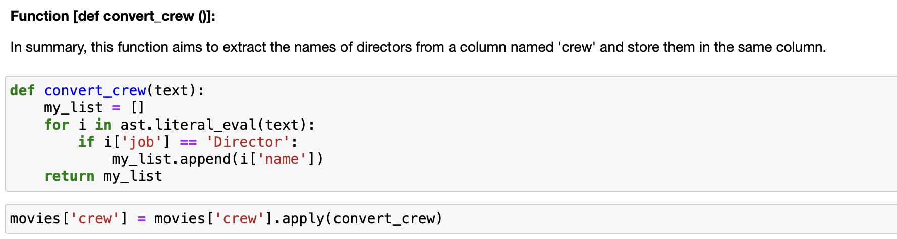
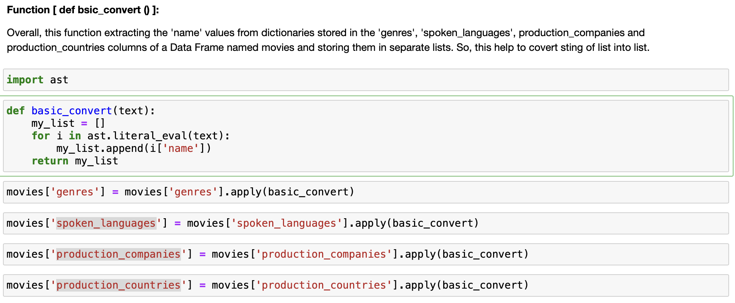
Data Cleaning:

Slide 7
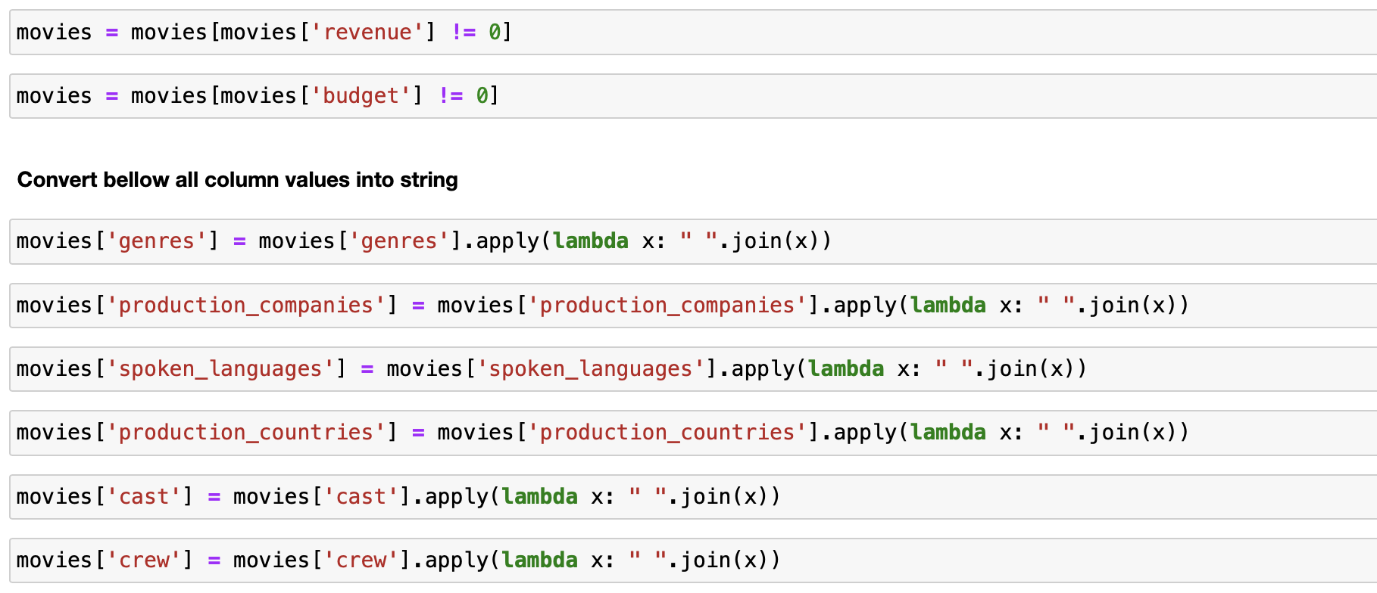
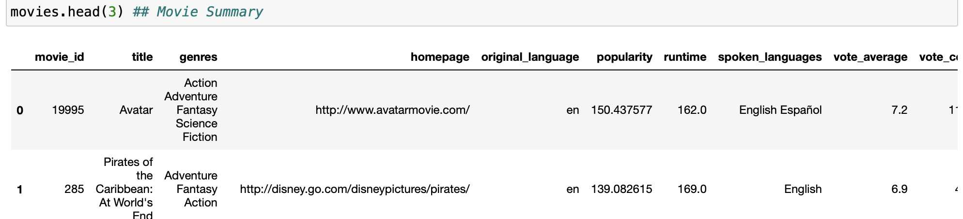
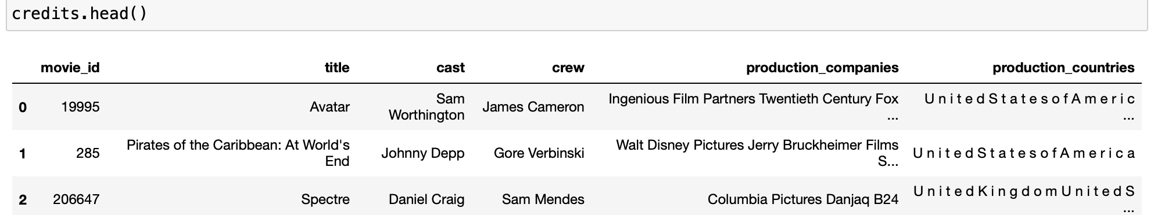
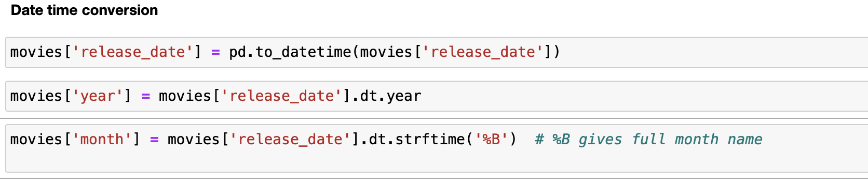
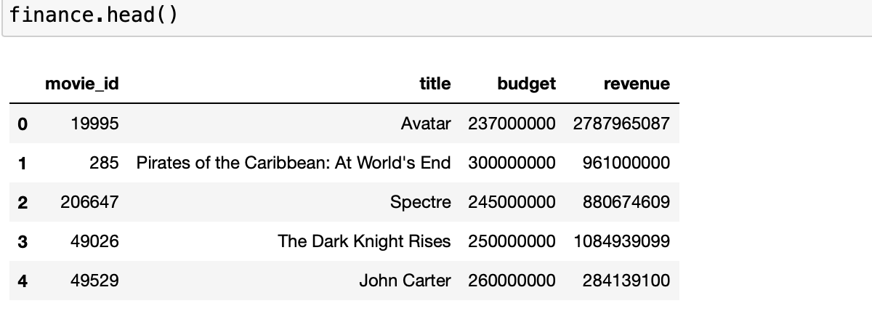
Data Cleaning:

Slide 8
Analysis questions:
How do total clicks and average page rank vary across different movie domains?
In which Language most queries was fired and which day of the month?
What is the distribution of movie genres, total revenue, and average popularity for the year 2006?
Does the popularity have impact on the revenue?
Is there a correlation between the collaboration of specific cast and crew members and the revenue of the movies they worked on?
What do the trends in movie popularity by genre over time resemble?

Slide 9
AOL Queries

Slide 10

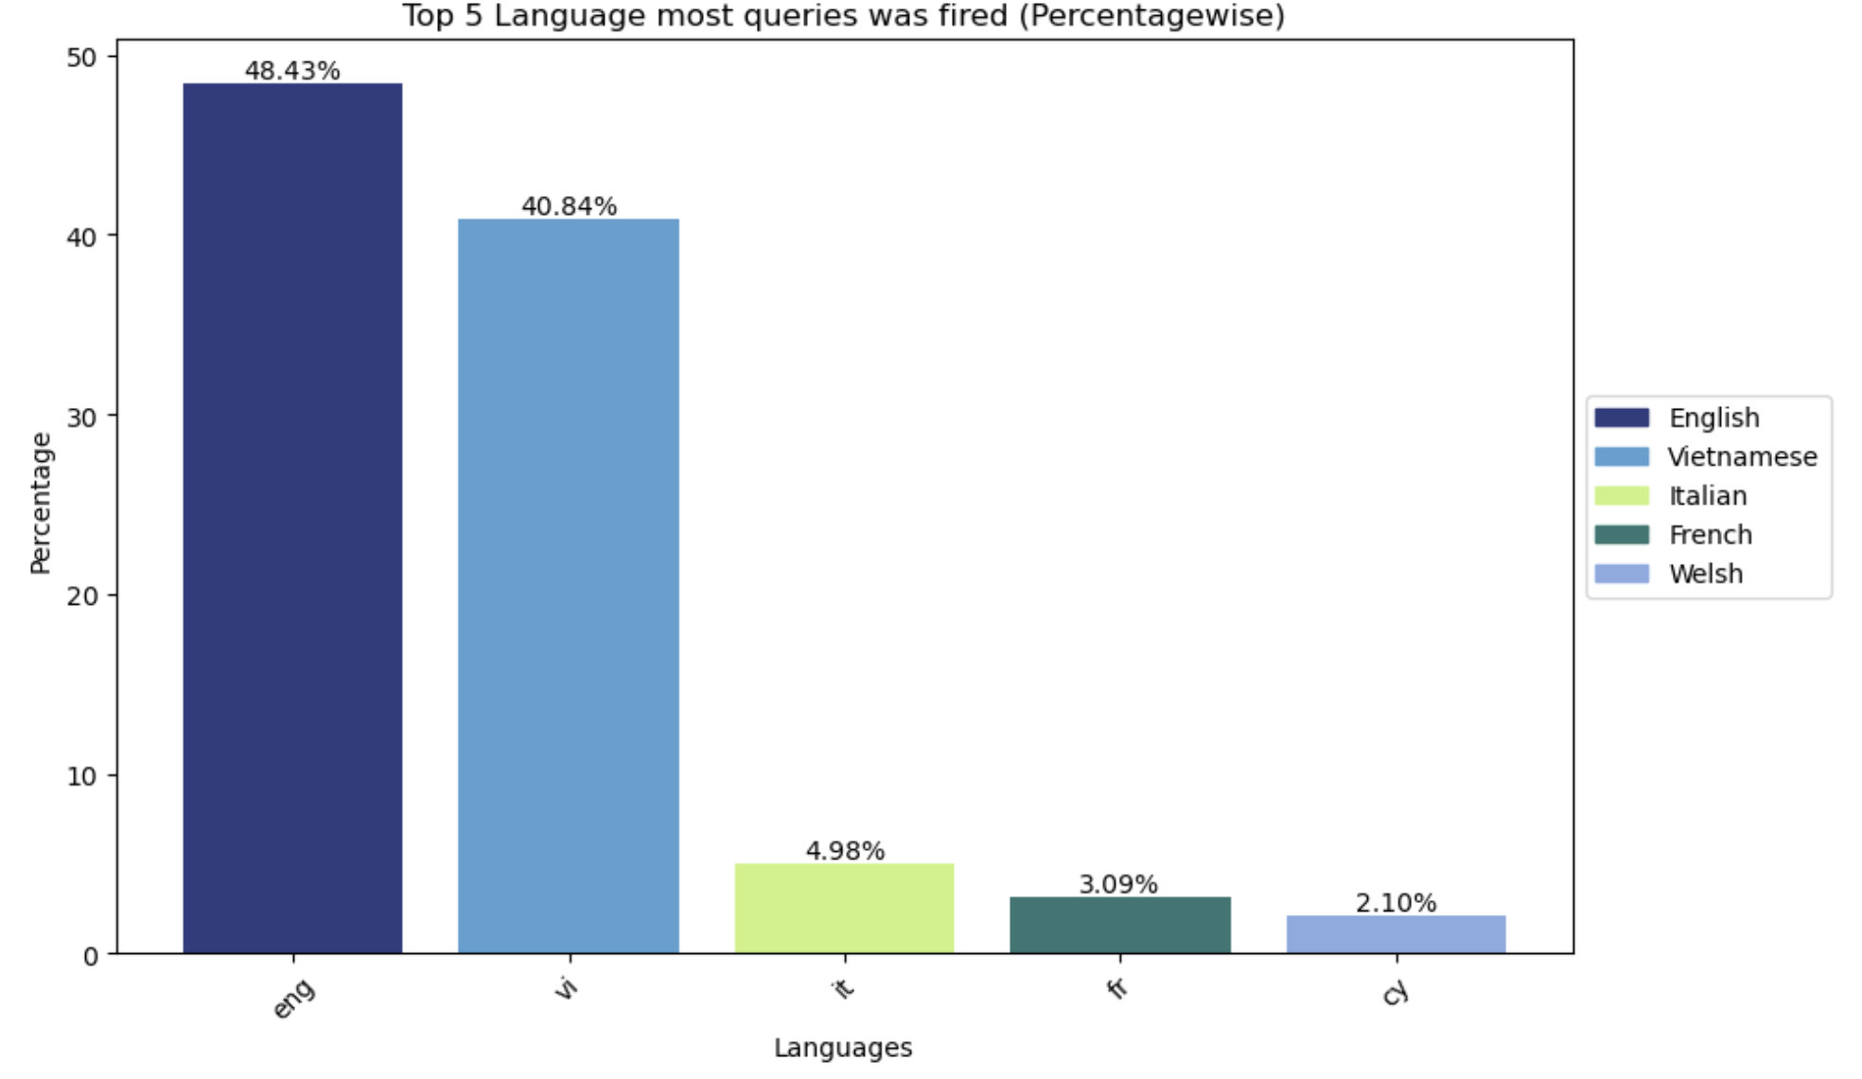
In which Language most queries was fired?

Slide 11
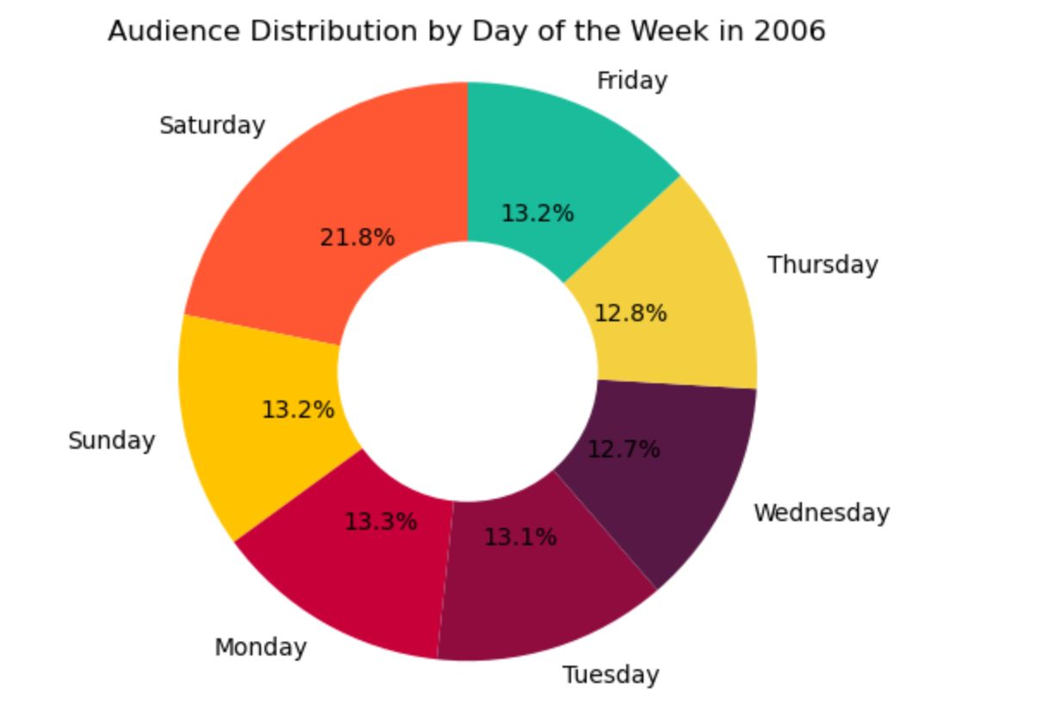
How has the distribution of active users evolved days of the week over 2006?

Slide 12

Extended AOL Queries

Slide 13

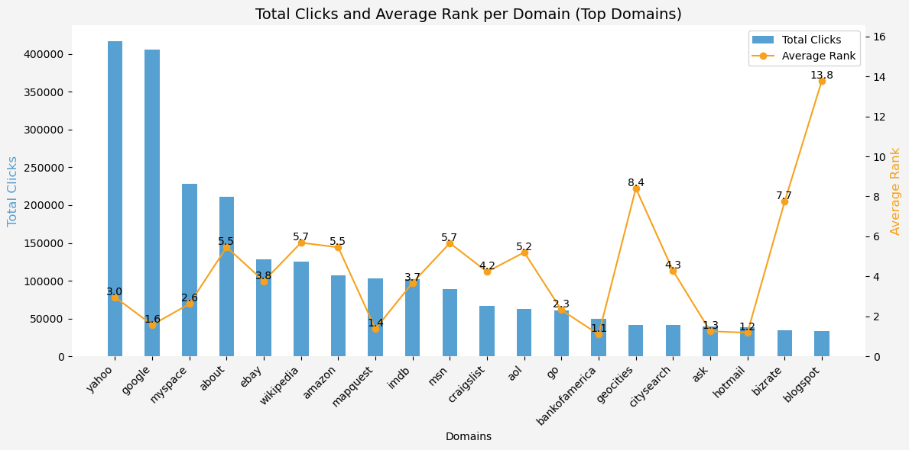
The highest total clicks is for the domain “Yahoo” with over 400k clicks with average rank 2.9.
How do total clicks and average page rank vary across different movie domains?

Slide 14

Is there a correlation between the collaboration of specific cast and crew members and the revenue of the movies they worked on?
Franchise Dominance: Franchises like Harry Potter, Star Wars, and Transformers have consistently high-grossing films, showcasing the enduring popularity and financial success of these series.
Diverse Genres: There's a mix of genres represented here, from fantasy (Harry Potter, Twilight) to animation (Inside Out, Frozen), action (Transformers, Mission: Impossible III), and drama (The Devil Wears Prada, Brokeback Mountain). It highlights the audience's varied preferences.
Actor Influence: Certain actors like Johnny Depp, Daniel Radcliffe, and Tom Hanks have appeared in multiple high-grossing films, demonstrating their box office draw and audience appeal.
Directorial Impact: Directors like Christopher Nolan, Michael Bay, and George Lucas have helmed several successful movies, showcasing their ability to attract audiences and deliver commercially successful films across genres.
Adaptations and Originals: There's a mix of adaptations (Harry Potter, Twilight, The Da Vinci Code) and original screenplays (Inside Out, Inception). Both have been successful, indicating that a well-executed adaptation or an original concept can resonate with audiences.
Actress Impact: Kristen Bell, Kristen Stewart, and Amy Poehler appear in high-grossing films, suggesting their influence and popularity in successful movie projects.
These takeaways highlight the influence of franchises, the importance of diversity in genre, the impact of certain actors and directors, the success of adaptations vs. original content, and the influence of specific actors and actresses in attracting audiences.

Slide 15

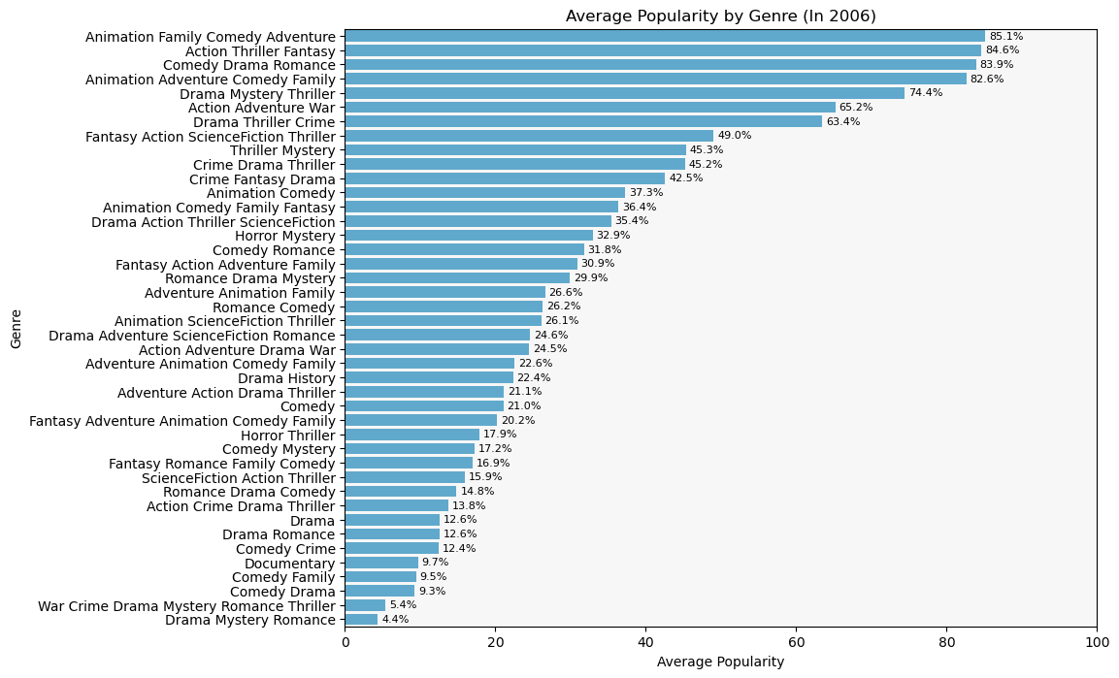
What is the distribution of movie genres, total revenue, and average popularity for the year 2006?
The dataset covers various genres, from Thriller Mystery and Animation Family Comedy Adventure to Drama, Comedy, Action, and more.
Genres like Animation Family Comedy Adventure, Action Thriller Fantasy, and Comedy Drama Romance seem to have higher average popularity scores.

Slide 16
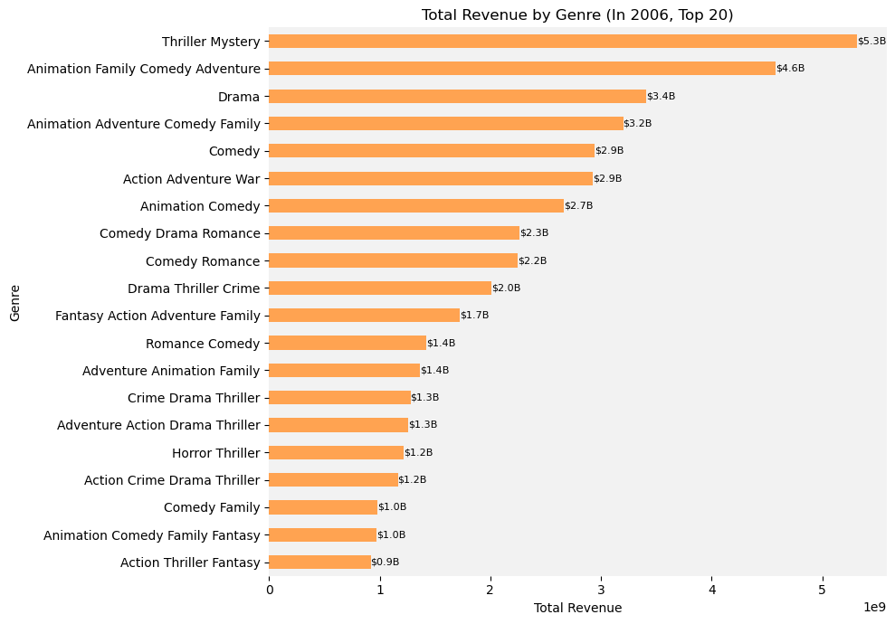
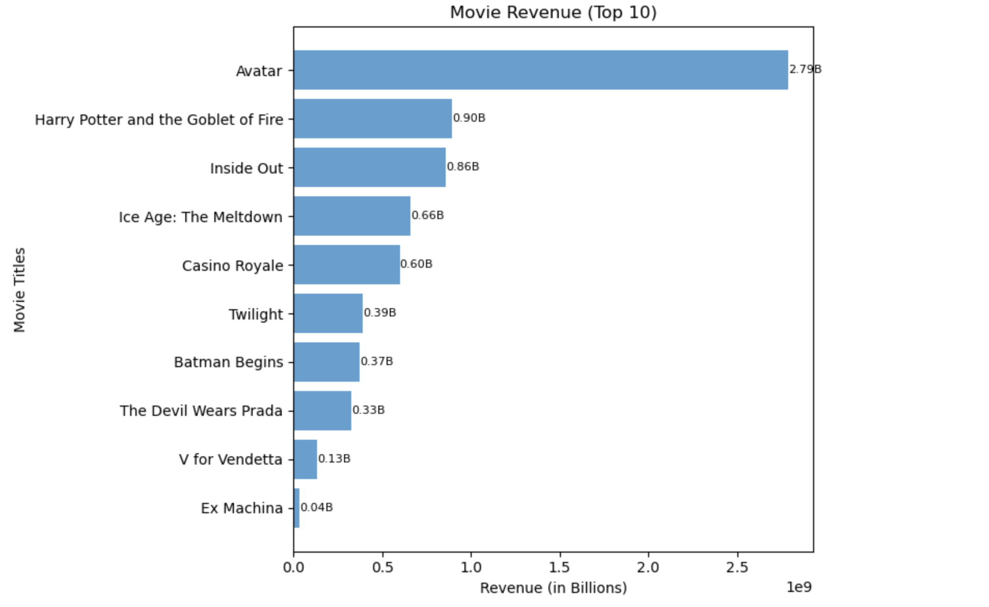
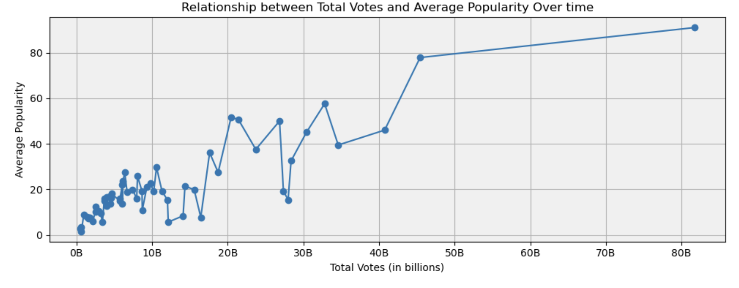
Popularity vs. Revenue:
Potential Trend:
However, genres like Animation Family Comedy Adventure and Action Thriller Fantasy, which score high in popularity, also showcase notable revenues.

Slide 17
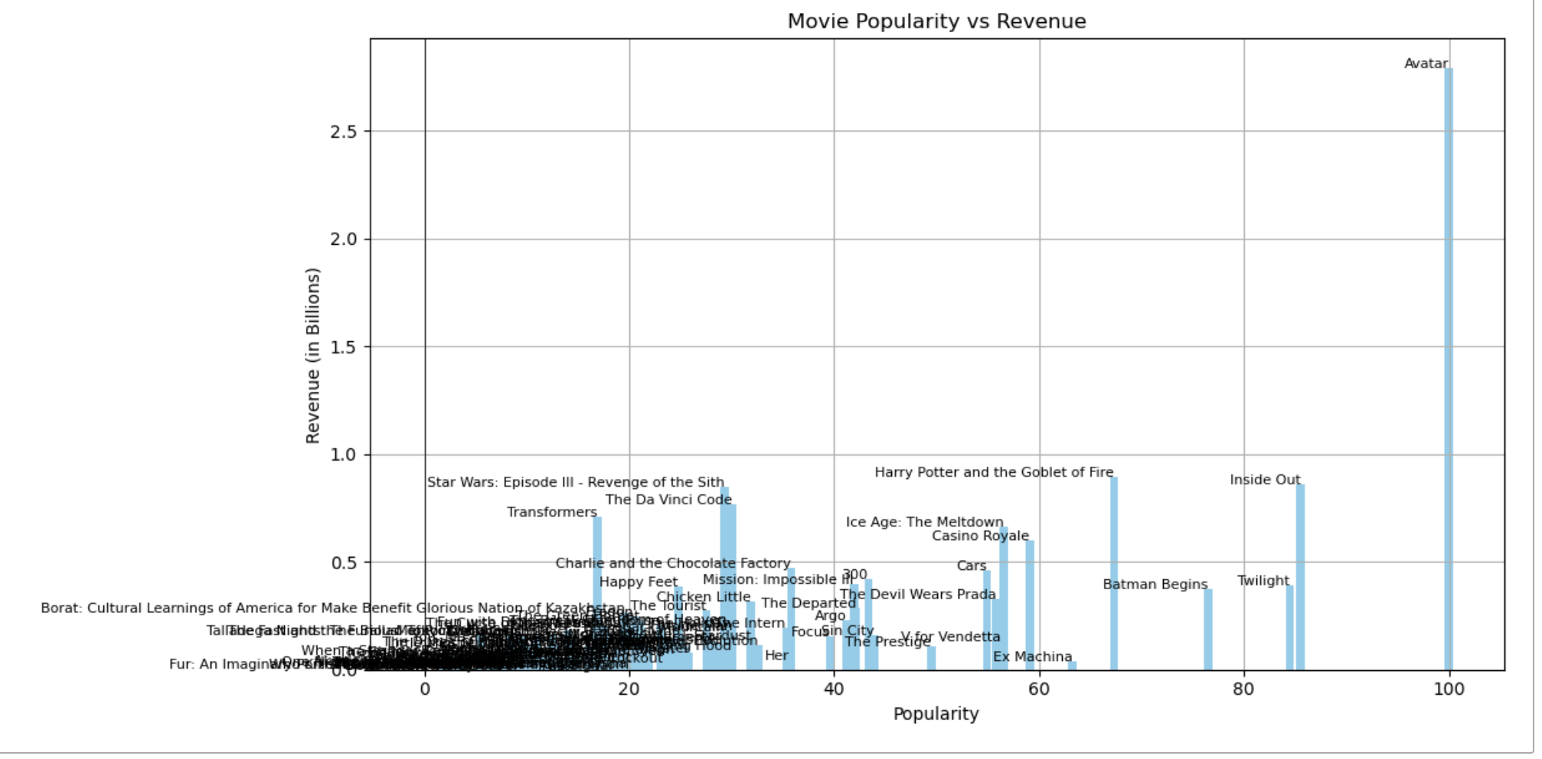
Does the popularity has impact on the revenue
Popularity-Revenue Correlation:
- The data demonstrates a general correlation between a movie's popularity and its revenue. High-popularity movies like "Avatar" tend to generate substantial revenue, indicating that audience interest often translates into financial success in the film industry.
- Despite the correlation, there are notable outliers. Movies like "Ex Machina" have lower popularity scores compared to others but also generate lower revenue. This suggests that while popularity is influential, other factors like niche appeal or marketing strategies also significantly impact a movie's financial success.
Variability in High-Popularity Movies:
- Among high-popularity movies, there's variance in revenue. For instance, while "Avatar" is at the top in popularity and revenue, other highly popular films like "Twilight" and "Batman Begins" have moderate revenue, indicating that popularity alone doesn't guarantee exceptionally high financial returns.
These insights highlight the nuanced relationship between a movie's popularity, audience reception, and its financial performance. They emphasize that while popularity is a crucial factor, it's not the sole determinant of a movie's box office success.

Slide 18

Tools That We Used
DataGrip
For the Queries
Python
Data Cleaning
Visualization

Slide 19

Challenges
Lack of knowledge on the topic and short time
Strategic Schema Alignment: Identifying Database Matches with Interconnected Columns
Absence of Direct Parameters for Connecting Movie Keys with existing schema.

Slide 20

Future Scope
Improving the Dataset by adding more information from popular stream dataset
Database Schema Optimization
Predictive Analytics for Revenue
Global Market Analysis

Slide 21

QUESTION?

Slide 22
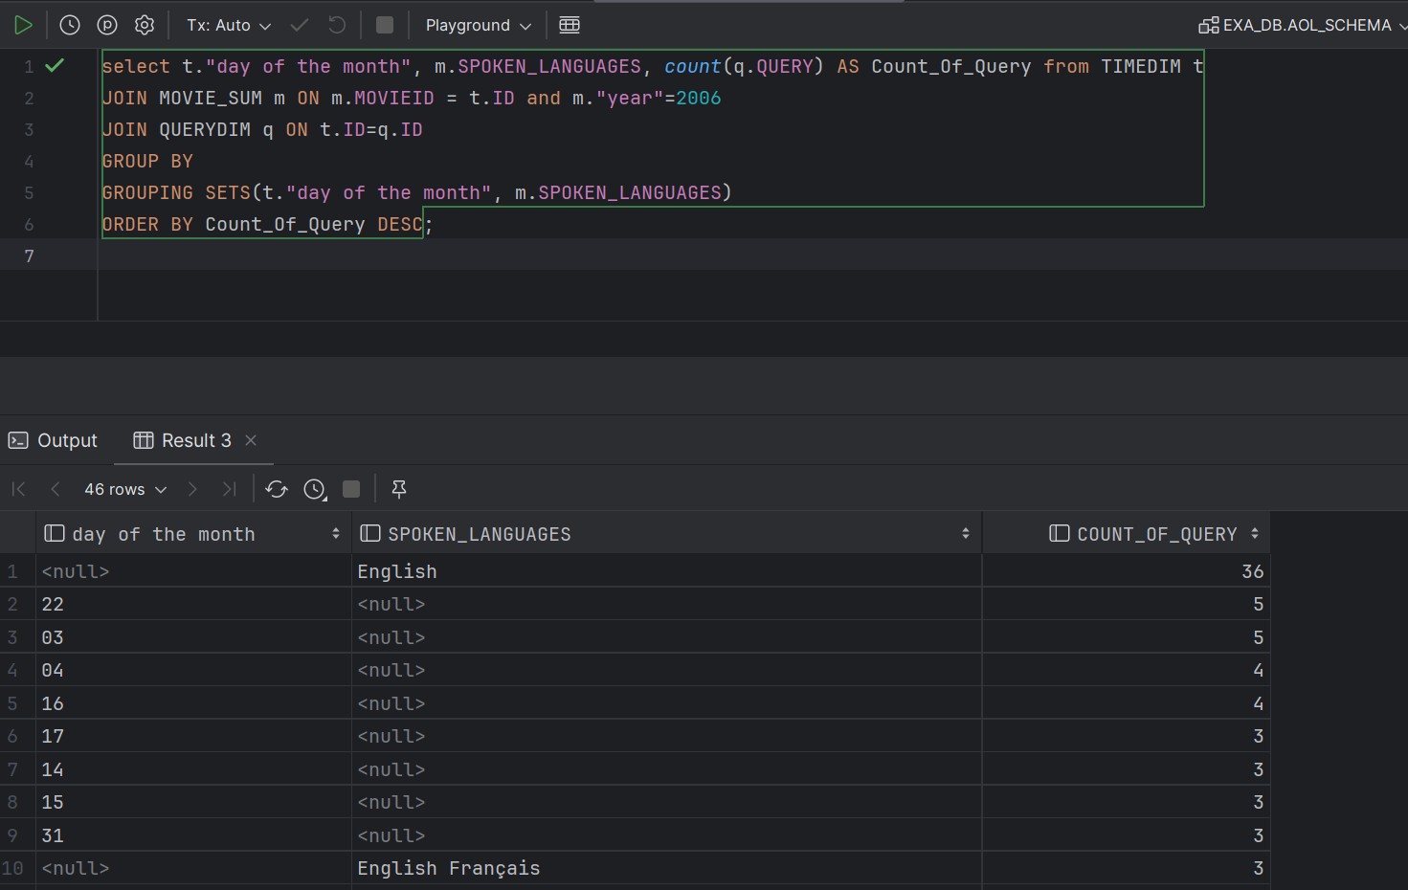
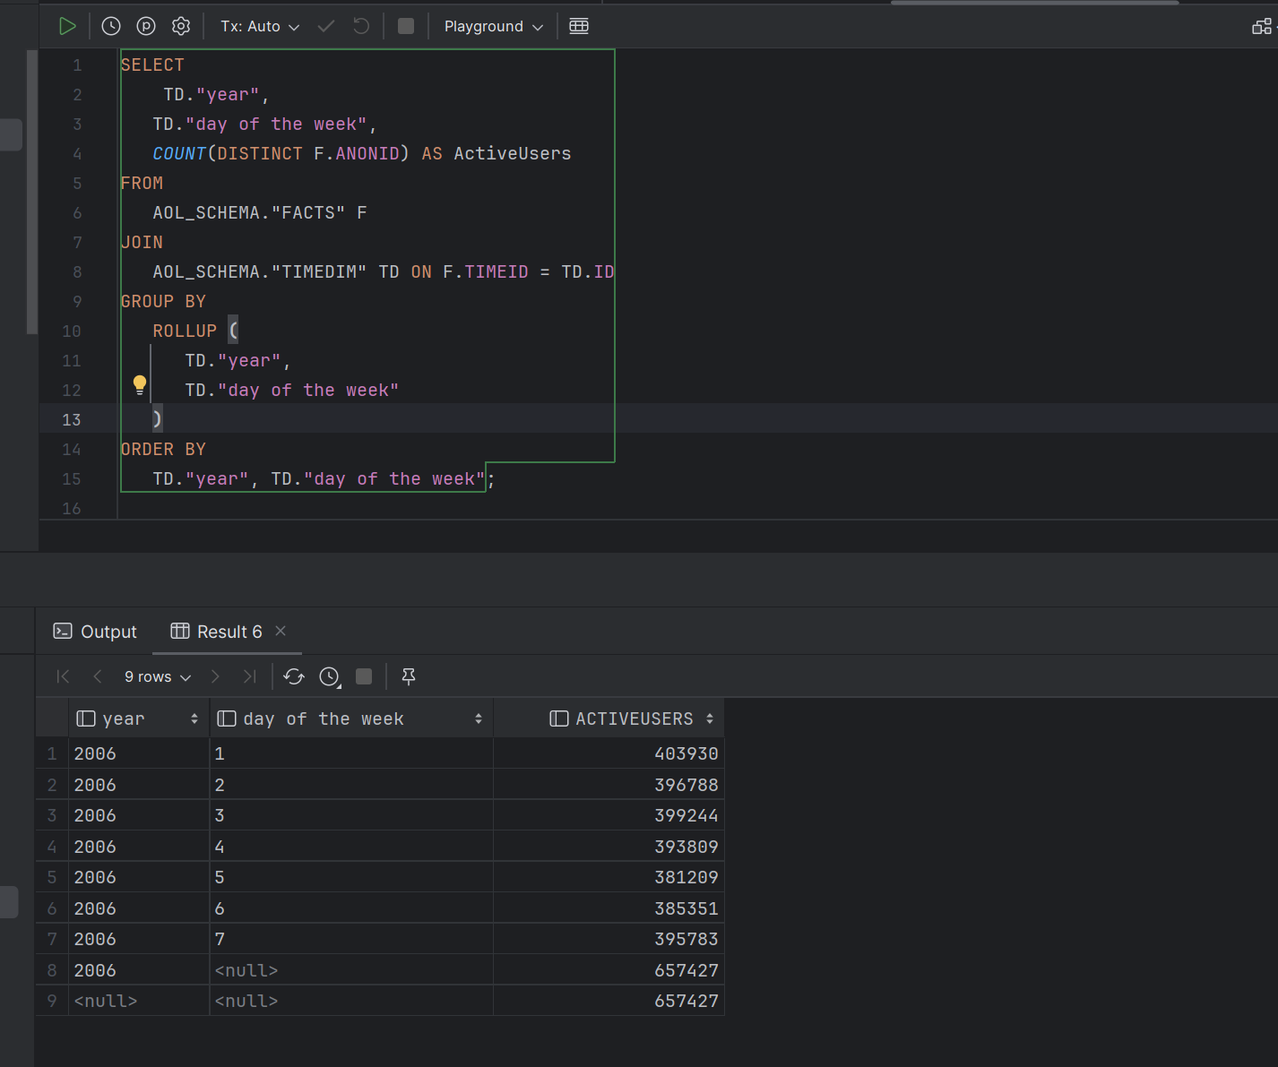
Appendix
Q1: In which Language most queries was fired and which day of the month
Q2:How has the distribution of active users evolved days of the week over 2006?

Slide 23
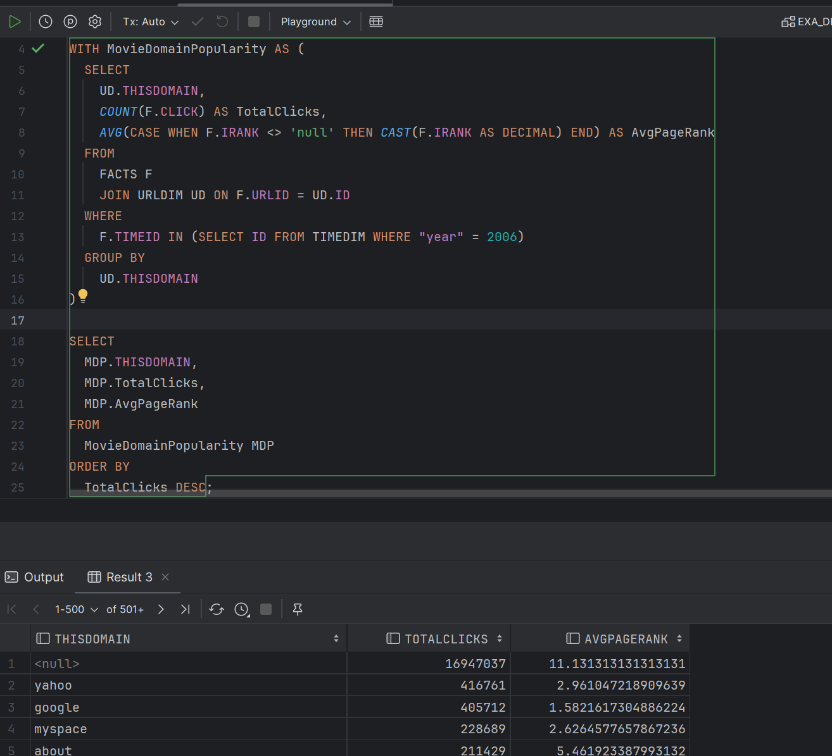
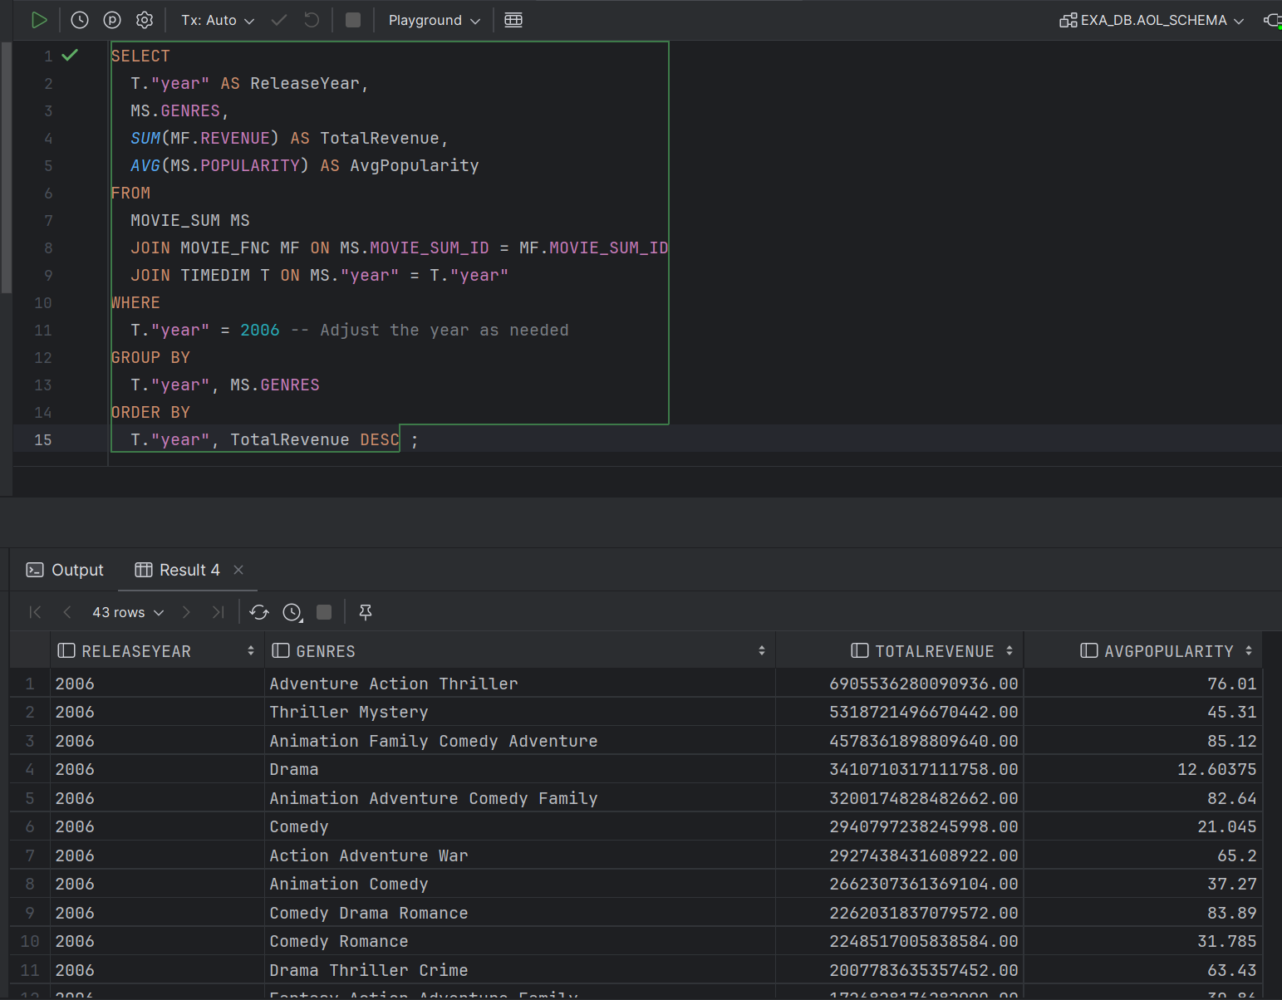
Q3: How do total clicks and average page rank vary across different movie domains?
Q4:What is the distribution of movie genres, total revenue, and average popularity for the year 2006?

Slide 24
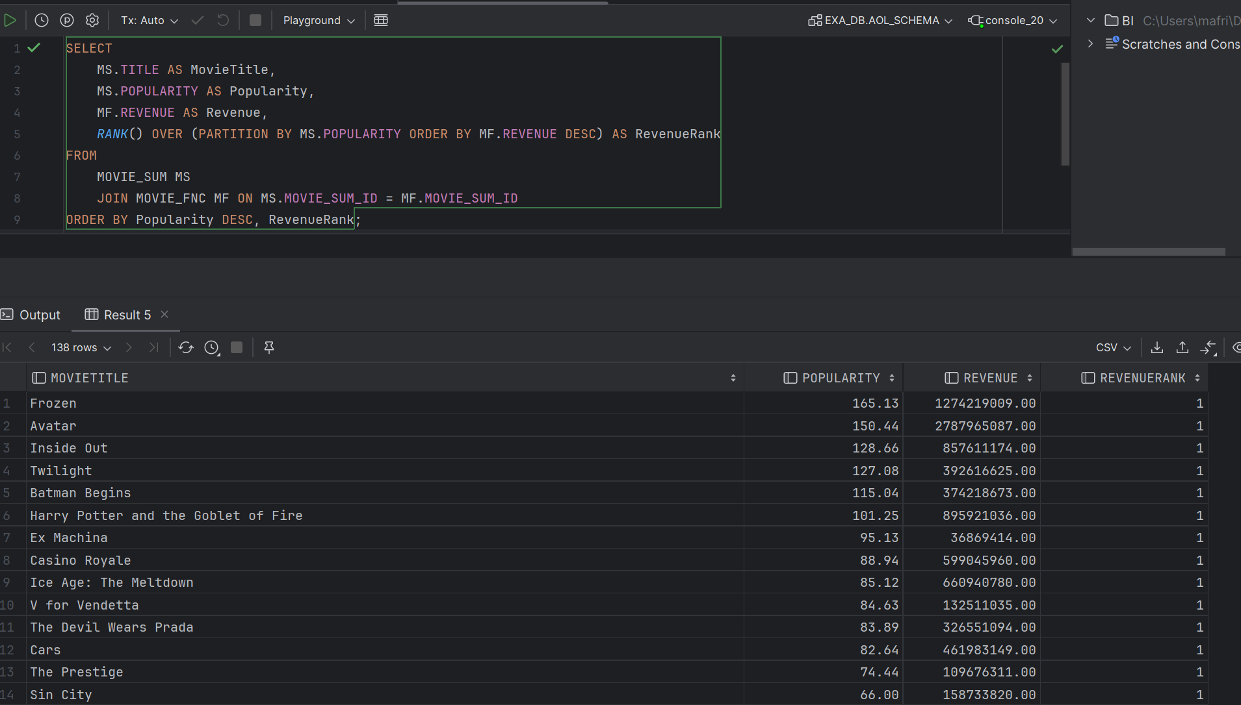
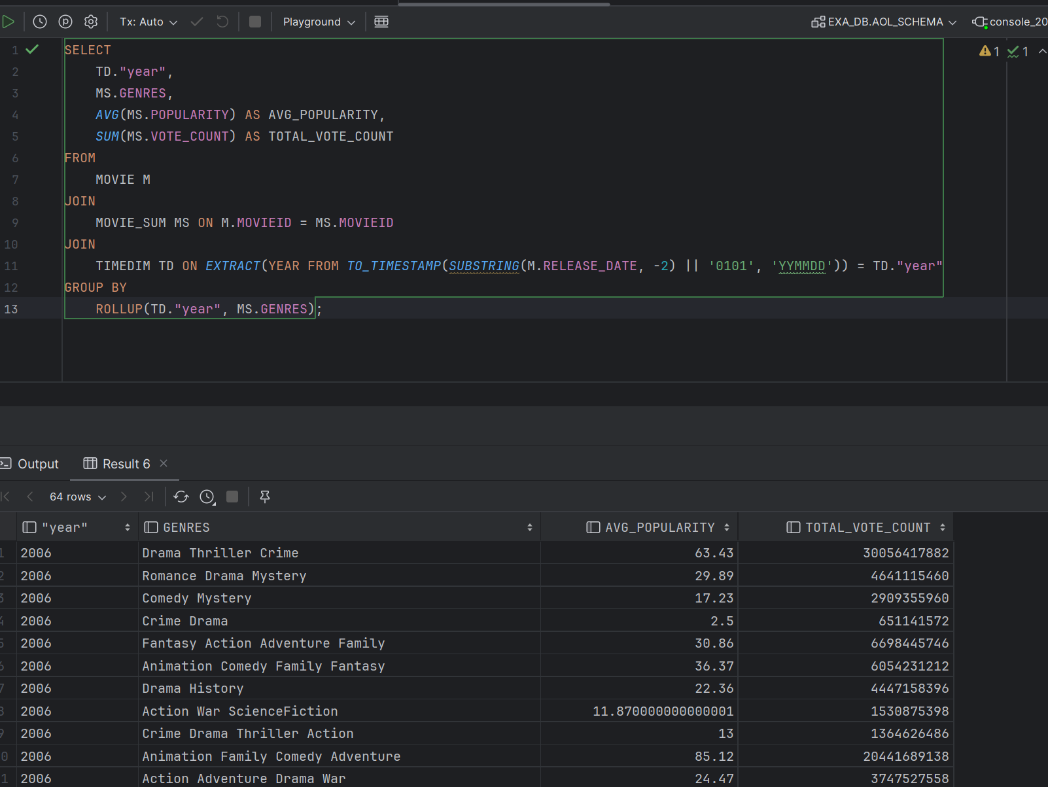
Q5: Does the popularity has impact on the revenue
Q6:Movie Popularity Trends by Genre Over Time

Slide 25
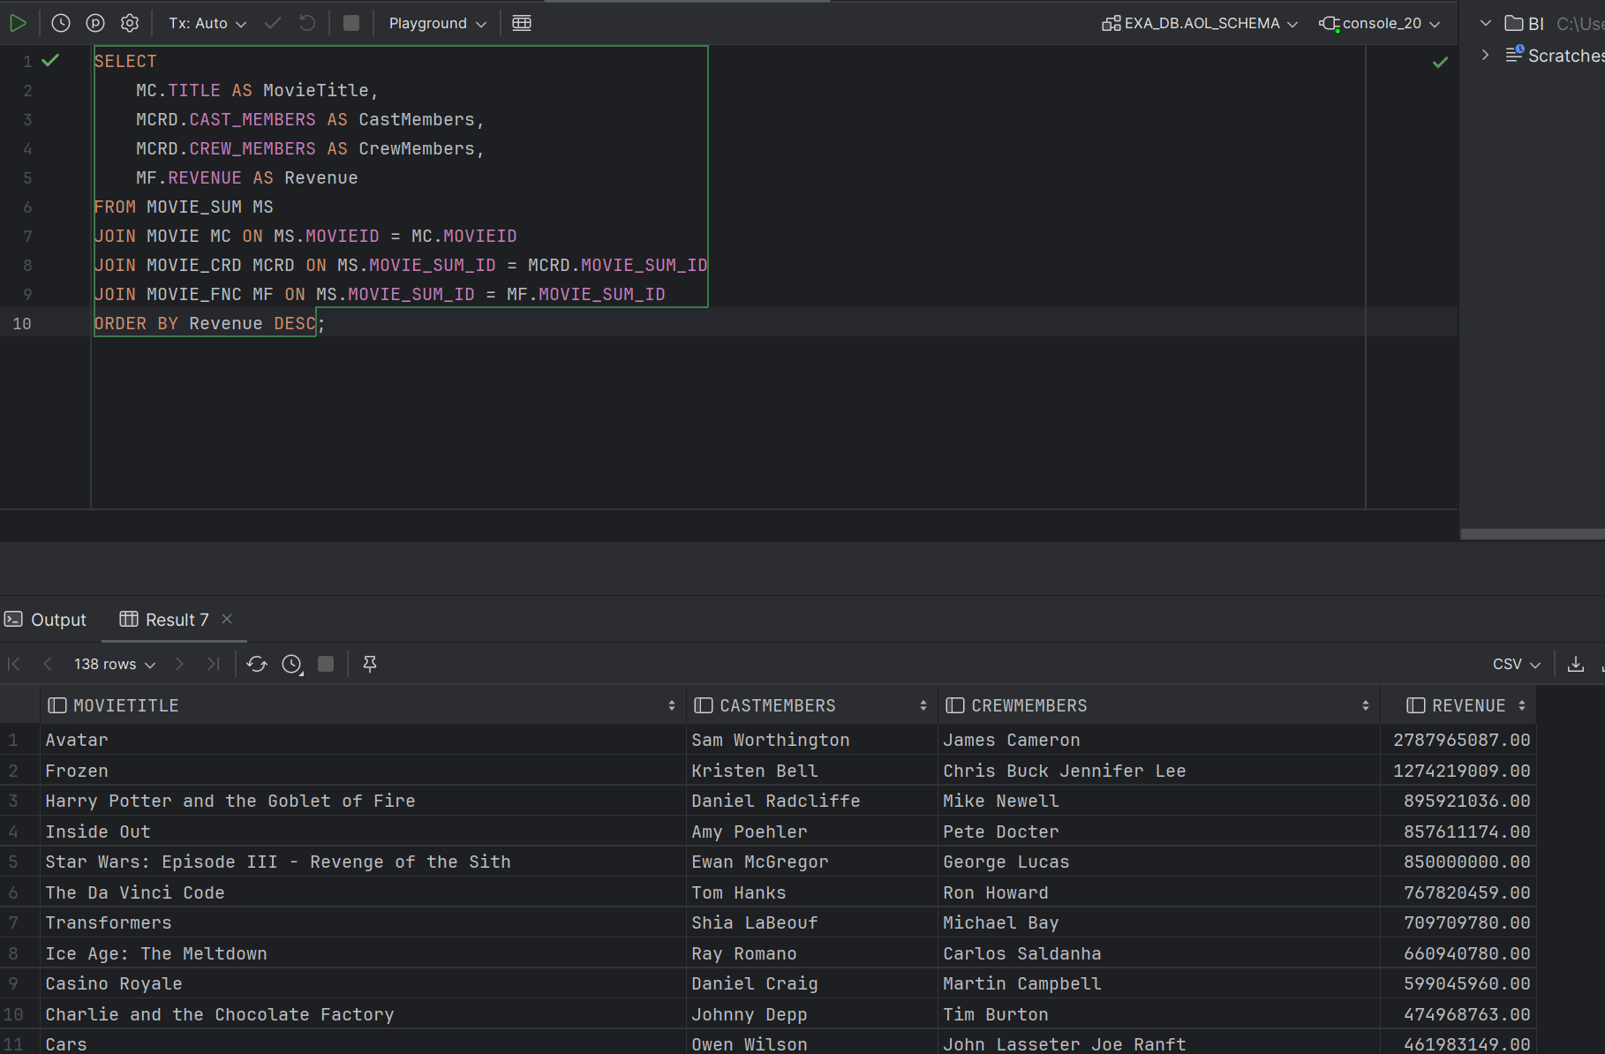
Q7: Is there a correlation between the collaboration of specific cast and crew members and the revenue of the movies they worked on?

Slide 26
Reference
Dataset: https://www.kaggle.com/datasets/tmdb/tmdb-movie-metadata

